Slide 1
From Print to Digital and Back Again
Adventures in Editing
Catherine E. Kelly
cathykelly@ou.edu

Slide 2
Editor, Common-place 2009-2013
www.common-place.org
Editor, Journal of the Early Republic 2014-
www.shear.org

Slide 4
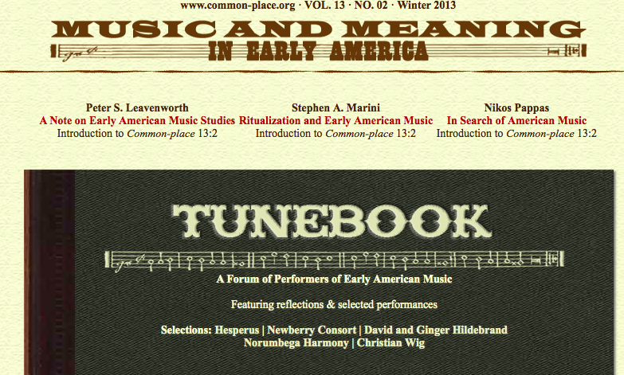
Leveraging Digital Media: Common-place
Sound

Slide 5
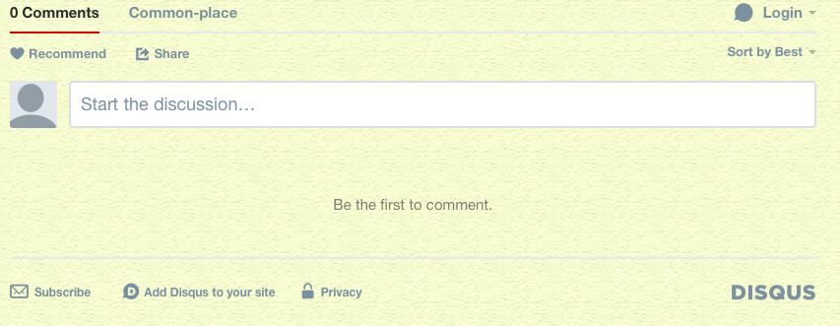
Leveraging Digital Media: Common-place
Interactive comment boxes

Slide 6
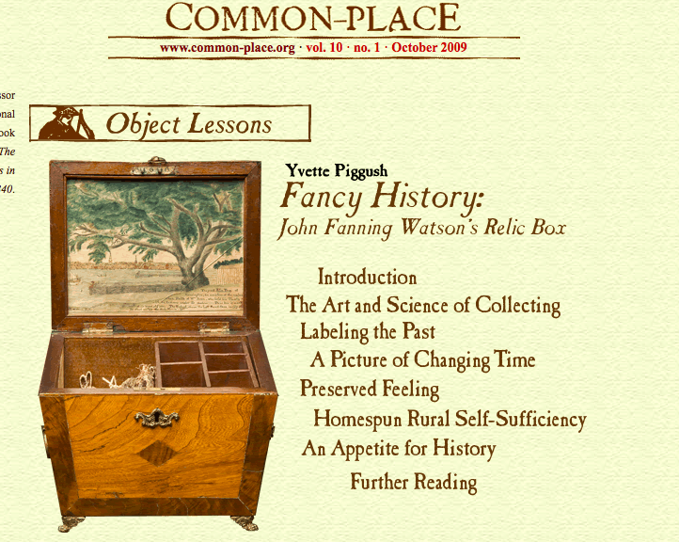
Leveraging Digital Media: Common-place
Using technology to challenge narrative structures & epistemologies

Slide 7
Leveraging Digital Media: Common-place
Lessons learned:
Change happens. But it happens slower than we might imagine.
Writing trumped technology every time.
But technology, especially social and digital media, can help build audiences for your writing.
Match digital media strategies to publications’ specific strengths & goals.

Slide 8
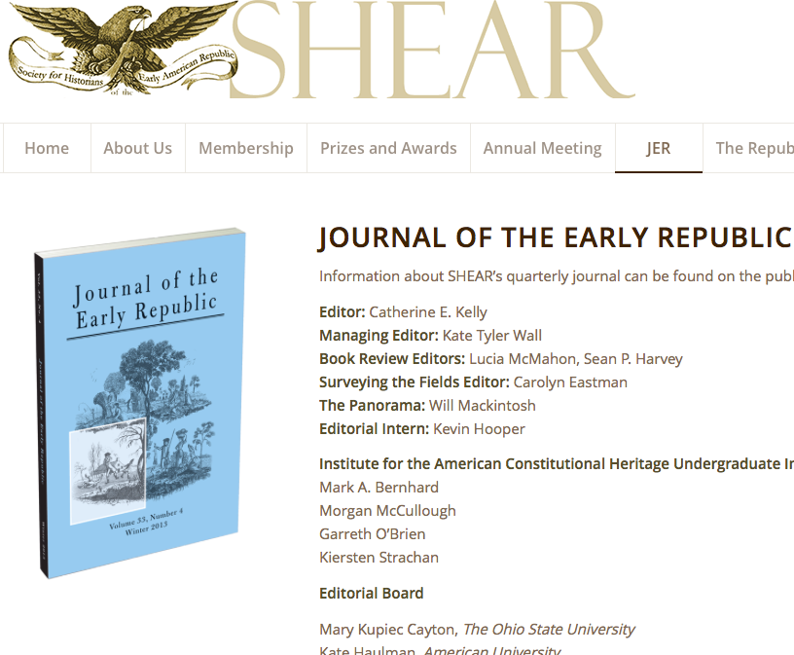
Starting From Scratch: Digital Media and the JER
No digital presence whatsoever.

Slide 9
Starting From Scratch: Digital Media and the JER
A blank page is an opportunity, not just a problem.
Phase I: IACH – JER Interns Spring 2015
Surveyed 15 academic organizations / journals to see how open access digital content could be used to enhance academic journals.

Slide 10
Starting From Scratch: Digital Media and the JER
Phase I Conclusions:
Everyone has to have supplemental OA content but most journals don’t really know what to do with it.
Reverse the flow: Use OA to create quality out of the box teaching content that would drive new readers to the JER.

Slide 11
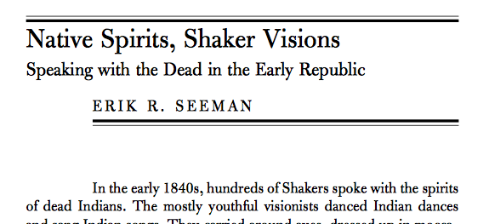
Starting From Scratch: Digital Media and the JER
Phase II: IACH- JER Interns 2015-2016
Create content based on JER article on Shakers who fell into trances, and channel the spirit voices of dead Native Americans.

Slide 12
Starting From Scratch: Digital Media and the JER
Phase II Conclusions:
Our logic was sound but ….
Execution, less so.

Slide 13
Starting From Scratch: Digital Media and the JER
Phase III: The Panorama
Create new partnerships
JER and University Mary Washington
Recruit social media coordinators
Extend and enhance JER: OA content will drop 4-5 times between quarterly publication dates.
Dual focus on JER as teaching tool and on research processes.

Slide 14
From Common-place to the JER
Lessons applied:
Integrate undergraduates into journal production in reasonable ways.
Maintain focus on writing
Use technology, especially social and digital media, to build audiences for your writing.
Match digital media strategies to JER’s specific strengths (research and writing) & goals (attract non-specialist teachers; promote JER in classrooms; highlight research).

